Slide 1
Chapter 4
Wireless Networking

Slide 2
Objectives
define the features of the 802.11 wireless LAN standard (Also called Wi-Fi)
understand the components of the wireless LAN
explore how wireless LANs are configured
examine how site surveys are done for wireless LANs
explore how to configure a point-to-point Wireless LAN

Slide 3
Overview
A typical computer network uses twisted pair and fiber optic cable to interconnect the LANs. Another media competing for use in higher data-rate LANs is wireless, based on the IEEE 802.11 wireless standard. The advantages of wireless include:
* User mobility in the workplace
* A cost effective networking media for use in areas that are difficult or too costly to wire.

Slide 4
Benefits of Wireless Networks
The benefits of wireless networks in the workplace are numerous. In order to provide wireless connectivity, the network administrator must make sure that the network services are reliable and secure.
Providing reliable network services means the network administrator must have a good understanding of wireless LAN (WLAN) configurations and technologies.
This and the following sections examine the fundamentals of wireless networking, the 802.11 standard and its family, 802.11b, 802.11a, and 802.11g and how wireless LANs are configured.

Slide 5
IEEE 802.11 Standard
The IEEE 802.11 wireless LAN standard defines the following:
Physical (PHY) layer
Medium Access Control (MAC) Layer,
MAC management protocols and services.

Slide 6
Physical Layer
The PHY (Physical) layer defines:
- The method of transmitting the data.
e.g. RF and Infrared.

Slide 7
Physical Layer Technologies
There are currently four physical layer technologies being used in 802.11 wireless networking. These are:
DSSS – Direct Sequence Spread Spectrum
FHSS – Frequency Hopping Spread Spectrum
Infrared
OFDM – Orthogonal Frequency Division Multiplexing.
DSSS is most often used in 802.11b and 11g wireless networks and OFDM is used in 802.11a.

Slide 8
802.11b frequencies
The 2.4 GHz frequency range used by 802.11b is shared by many technologies including Bluetooth, cordless telephones, and other wireless LANs emit significant RF noise in the 2.4 GHz range that can affect wireless data.
A significant improvement in wireless performance is available with the IEEE 802.11a standard. The 802.11a equipment operate in the 5 GHz range as opposed to the 2.4 GHz range for 802.11b and 802.11a provides significant improvement with RF interference.

Slide 9
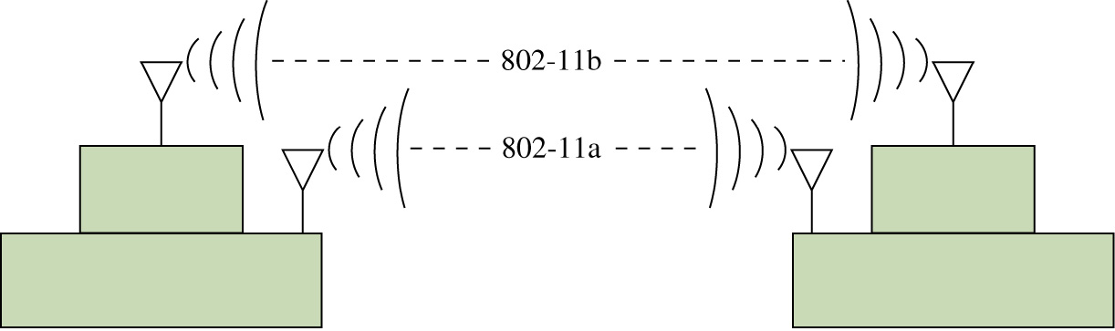
802.11a and b
IEEE 802.11a equipment is not compatible with 802.11b. The good aspect of this is the 802.11a equipment will not interfere with 802.11b. Therefore 802.11a and 802.11b links can run next to each other without causing any interference. An example of the two links operating together is shown in Fig. 11-5.

Slide 10
802.11g
Another IEEE 802.11 wireless standard is the IEEE 802.11g. The 802.11g standard supports the higher data transmission rates of 54 Mbps but operates in the same 2.4 GHz range as 802.11b.
The 802.11g equipment is also backward compatible with 802.11B equipment. This means that 802.11b wireless clients will be able to communicate with the 802.11g access-points and the 802.11g wireless client equipment will communicate with the 802.11b access-points.
The obvious advantage of this is companies with an existing 802.11b wireless network will be able to migrate to the higher data rates provided by 802.11g without having to sacrifice network compatibility. In fact some of the new wireless equipment supports both the 2.4 GHz and 5 GHz standards.

Slide 11
802.11n
Another entry into wireless networks is the 802.11n. This wireless technology can operate in the same ISM frequency as 802.11b/g (2.4GHz) and can also operate in the 5 GHz band.
A significant improvement with 802.11n is MIMO (Multiple Input Multiple Output). MIMO uses a technique called space-division multiplexing where the data stream is split into multiple parts called spatial streams. The different spatial streams are transmitted using separate antennas.
With MIMO, doubling the spatial streams doubles the effective data rate. The downside of this is there can be increased power consumption.
The 802.11n specification includes a MIMO power-save mode. With this, 802.11n only uses multiple data paths when faster data transmission is required thus saving power.

Slide 12
802.11ac
The latest addition to the 802.11 family is 802.11ac. The 802.11ac technology operates in the 5GHz band.
It uses a new version of MIMO technology with eight spatial streams and has channels up to 80MHz wide. This is called Multiuser MIMO (MUMIMO).
802.11ac incorporates standardized beamforming. Beamforming is a technique that is used to direct transmission of the radio signal to a specific device.
The benefit of this is increasing data throughput while reducing power consumption. 802.11n used beamforming but this was not standardized.
The transmit range for 802.11ac is similar to or better than 802.11n.

Slide 13
WiFi
Wireless networks also go by the name Wi-Fi which is the abbreviated name for the Wi-Fi Alliance (Wi-Fi stands for wireless fidelity).
The Wi-Fi Alliance is an organization whose function is to test and certify wireless equipment for compliance with the 802.11x standards.
802.11x is the group of wireless standards developed under the IEEE802.11 standard.

Slide 14
Wireless Standards
802.11a (Wireless-A): This standard can provide data transfer rates up to 54 Mbps and an operating range up to 75 feet. It operates at 5GHz (Modulation – OFDM)
802.11b (Wireless-B): This standard can provide data transfer rates up to 11Mbps with ranges of 100 to 150 feet. It operates at 2.4 GHz. (Modulation – DSSS)
802.11g (Wireless-G): This standard can provide data transfer rates up to 54 Mbps up to 150 feet. It operates at 2.4 GHz. (Modulation – DSSS or OFDM))

Slide 15
Wireless Standards
802.11n (Wireless-N): This is the next generation of high-speed wireless connectivity promising data transfer rates over 200+ Mbps. It operates at 2.4 Ghz and also 5 GHz. (Modulation – DSSS or OFDM)
802.11ac: This is the next generation of high-speed wireless connectivity. This technology promises data rates up to 1Gbps. It operates over the 5GHz band.
802.11i: This standard for wireless LANs (WLANs) provides improved data encryption for networks that use the 802.11a, 802.11b, and the 802.11g standards.
802.11r: This standard is designed to speed handoffs between access points or cells in a wireless LAN. This standard is a critical addition to 802.11 WLANs if voice traffic is to become widely deployed.

Slide 16
MAC Layer
The MAC (Media Access Control) layer defines
the reliability of the data service
access control to the shared wireless medium
protecting the privacy of the transmitted data

Slide 17
Wireless Management Protocols
The wireless management protocols and services are:
- authentication, association, data
delivery, and privacy

Slide 18
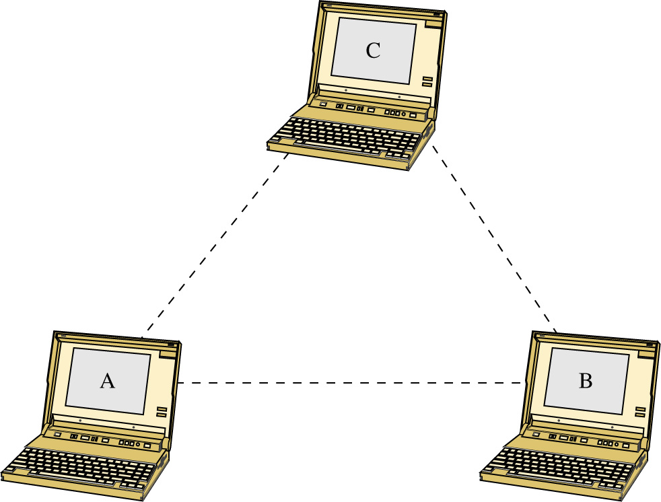
Basic Service Set (BSS)
The basic topology of the WLAN is the Basic Service Set (BSS). This is also called the independent Basic Service Set or “ad hoc” network. An example of an ad hoc network is provided. In this network, the wireless clients (stations) communicate directly with each other. This means that the clients have recognized the other stations in the wireless LAN and have established a wireless data link.

Slide 19
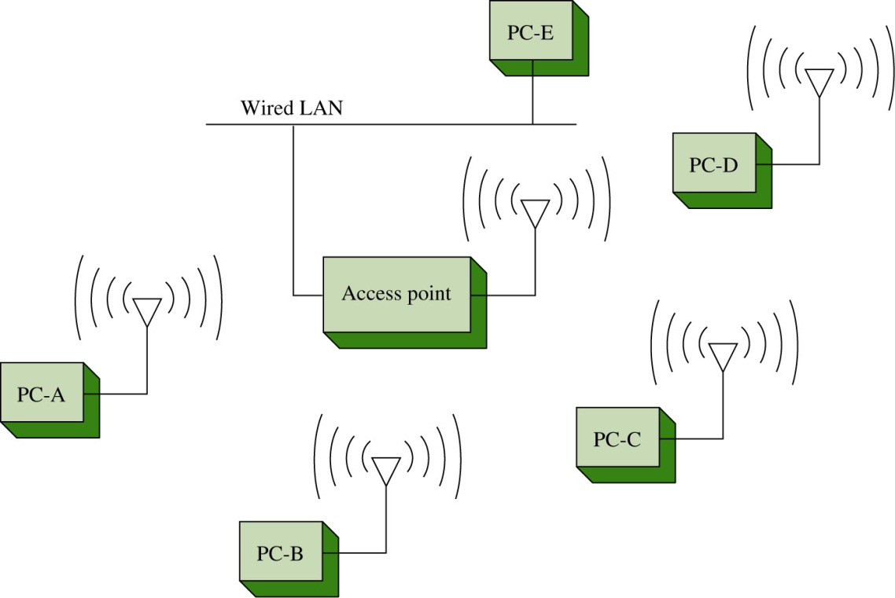
Access Points
The performance of the Basic Service Set can be improved by including an access point. The access point is a transmit/receive unit (transceiver) that interconnects data from the wireless LAN to the wired network.
The access point typically uses an RJ-45 jack for connecting to the wired network. If an access point is being used, the users establish a wireless communications link through the access point to communicate with other users in the WLAN or the wired network as shown.

Slide 20
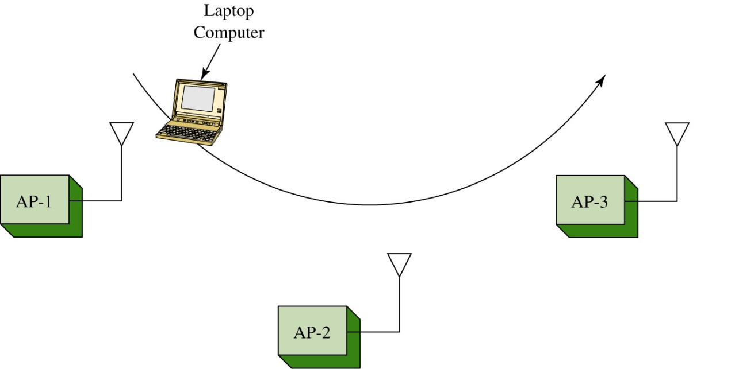
Basic Service Set - Problems
The problem with the Basic Service Set is mobile users can travel outside the radio range of a station’s wireless link with one access point. A solution is to add multiple access points to the network. The multiple access points extend the range of mobility of a wireless client in the LAN. This arrangement is called an Extended Service Set (ESS). An example is shown.

Slide 21
Basic Service Set - Problems
The mobile computer will establish an authorized connection with the access point that has the strongest signal level (e.g. AP-1). As the mobile user moves, the signal strength of the signal from AP-1 will decrease. At some point in the mobile users travel, the signal strength from AP-2 will exceed AP-1 and the wireless bridge will establish a new connection with AP-2. This is an automatic process for the wireless client adapter in 802.11.

Slide 22
CSMA/CA
Network access in 802.11 uses a technique called Carrier Sense Multiple Access / Collision Avoidance (CSMA/CA).
In CSMA/CA, the client station listens for other users of the wireless network. If the channel is quiet, the client station may transmit. If the channel is busy, the station(s) must wait until transmission stops.
Each client station uses a unique random back-off time. This technique prevents the client stations from trying to gain access to the wireless channel as soon as it becomes quiet.

Slide 23
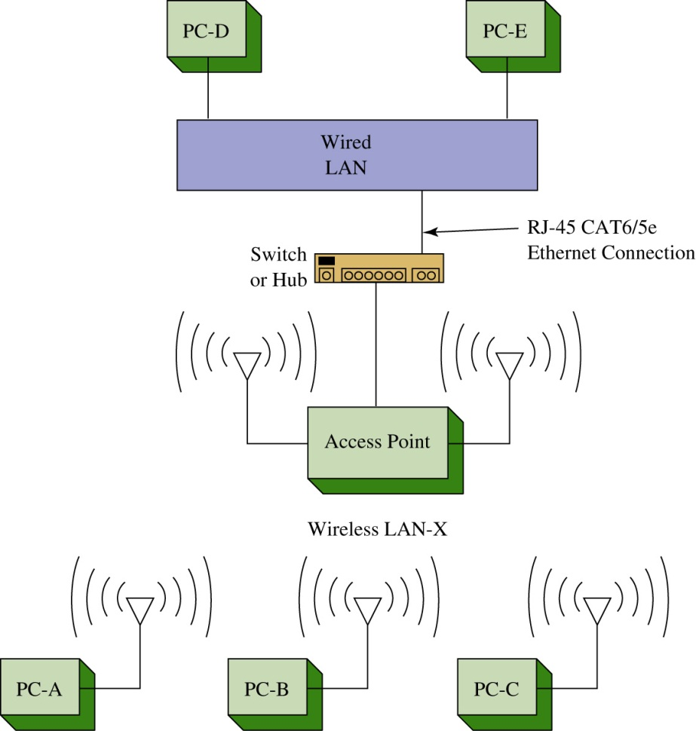
An example of a basic 802.11b wireless
LAN configuration is shown. Each PC is
outfitted with a wireless LAN adapter
card.
The wireless adapter (wireless LAN
adapter) is the device that connects the
client to the wireless medium. The
medium is typically a radio wave
channel in the 2.4 GHz ISM
(Instrumentation, Scientific, and
Medical) band.

Slide 24
The wireless medium can also be
infrared although it is not used very
often. The services provided by the
wireless LAN adapter are
the delivery of the data
authentication
privacy

Slide 25
The connection to a wired LAN is provided by a wireless access point.
The purpose of the access point is to provide a bridge between the wireless LAN and the wired network. A physical cable connection (typically CAT6/5e) ties the access point to the wired network’s switch or hub (typically Ethernet).

Slide 26
The connection to a wired LAN is provided by a wireless access point.
The purpose of the access point is to provide a bridge between the wireless LAN and the wired network. A physical cable connection (typically CAT6/5e) ties the access point to the wired network’s switch or hub (typically Ethernet).

Slide 27
For example, computer PC-A sends a data packet to PC-D, a destination in the wired LAN. PC-A first sends a data packet over the wireless link.
The access point recognizes the sender of the data packet as a host in the wireless LAN-X and allows the wireless data to enter the access point.
At this time, the data is sent out the physical Ethernet connection to the wired LAN. The data packet is then delivered to PC-D in the wired LAN.

Slide 28
SSID
A question should come up at this point, how does the access point know that the wireless data packet is being sent from a client in the wireless LAN?
The answer is, the 802.11 wireless LAN devices use an SSID to identify what wireless data traffic is allowed to connect to the network. The SSID is the wireless service set identifier.
Basically, the SSID is a password that enables the client to join the wireless network. The access point uses the SSID to determine if the client is to become a member of the wireless network. The term used to describe that a wireless connection has been obtained is called an association.

Slide 29
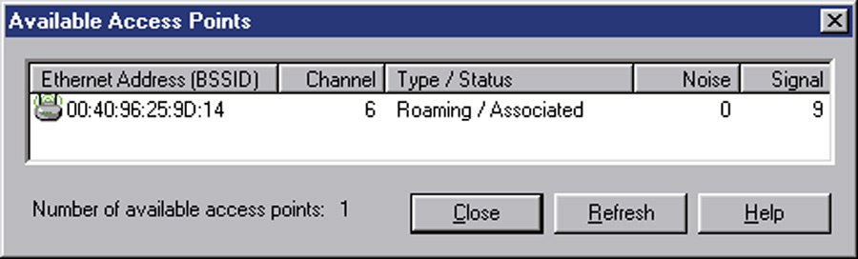
An example of the information displayed on the wireless adapter’s console port when an association is made is shown. The text indicates that a connection has been made to a parent (Access Point) and the MAC address for the parent is 00-40-96-25-9d-14.
The text indicates this MAC address has been “added” to the list of associations. This type of information is typically available via the wireless management software that typically comes with the wireless PC or PCMCIA adapter.

Slide 30
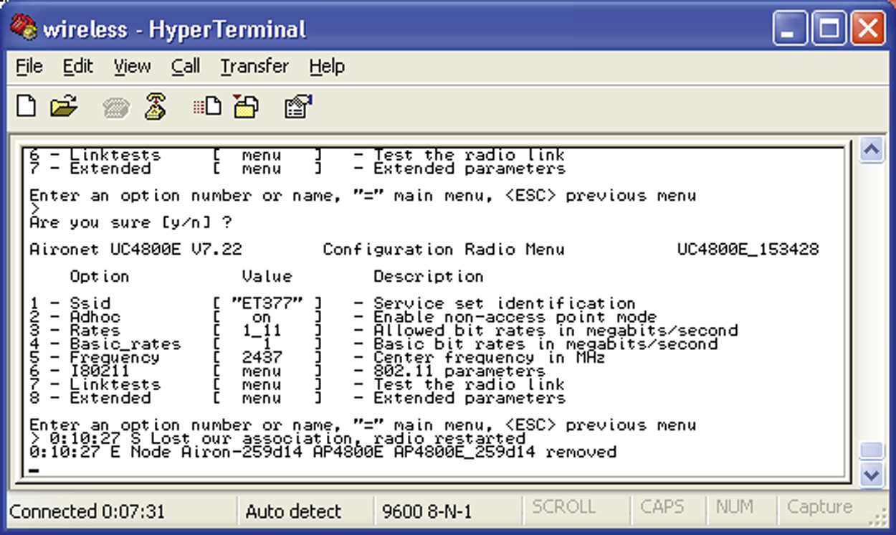
Access points use the association to build a table of users (clients) on the wireless network. The association table lists the MAC addresses for each networking device connected to the wireless network. The access point then uses this table to forward data packets between the access point and the wireless network.
The wireless client adapter will also notify the user if the client has lost an association with the access point.

Slide 31
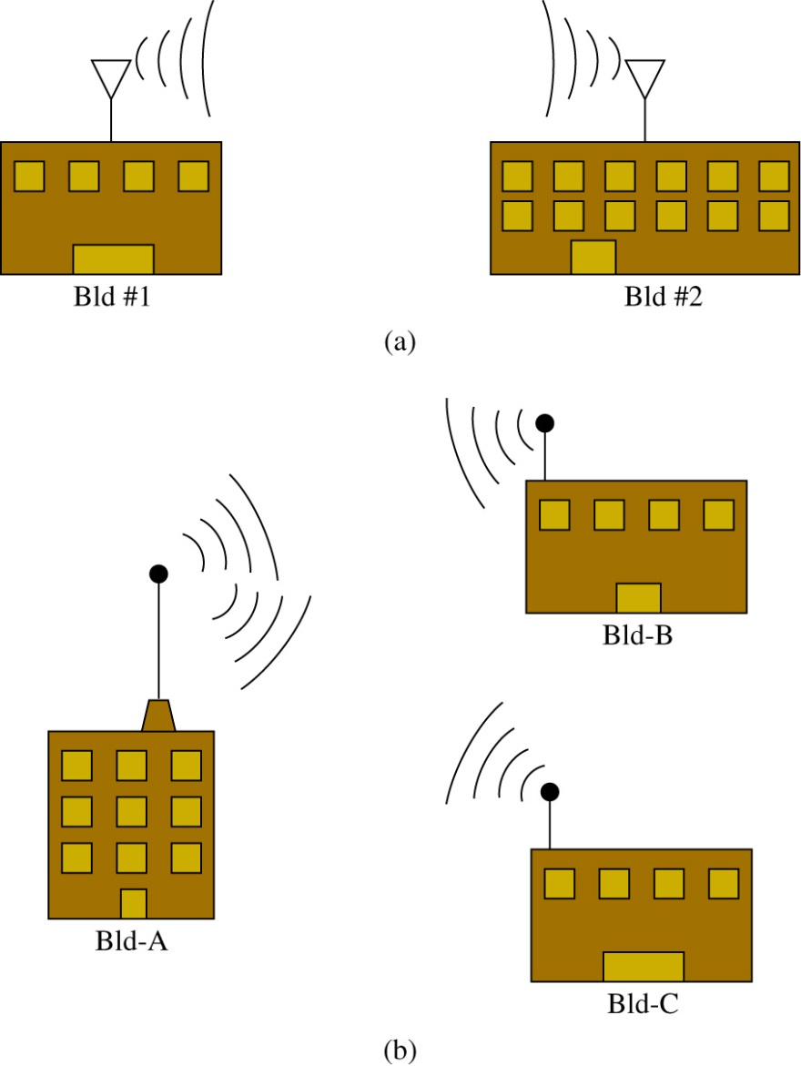
A wireless bridge is a popular choice for connecting LANs (running similar network protocols) together even if the LANs are miles apart. Examples are provided.
Fig. (a) shows a point-to-point wireless bridge.
Fig. (b) shows a point-to-multipoint wireless bridge

Slide 32
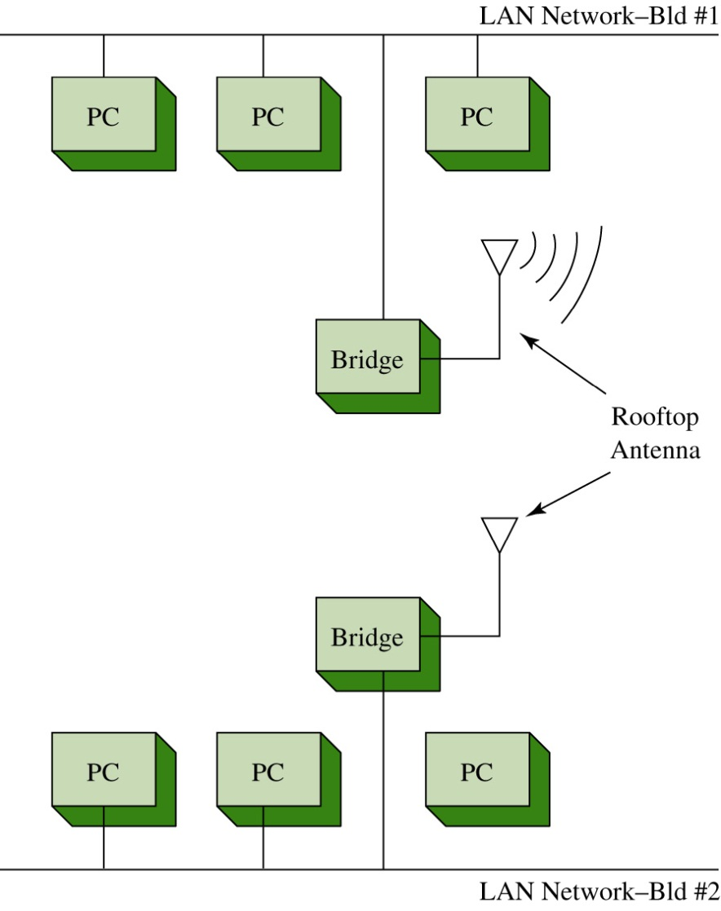
The connection to the wired LANs.

Slide 33
Design Issues
Wireless LANs have a maximum distance the signal can be transmitted. This is a critical issue inside building when user mobility is required.
There are many obstacles that reflect and attenuate the signal causing reception to suffer. Also, the signal level for mobile users is hampered by the increased distance from the access point.
Distance is also a critical issue in outdoor point-to-multipoint wireless networks.

Slide 34
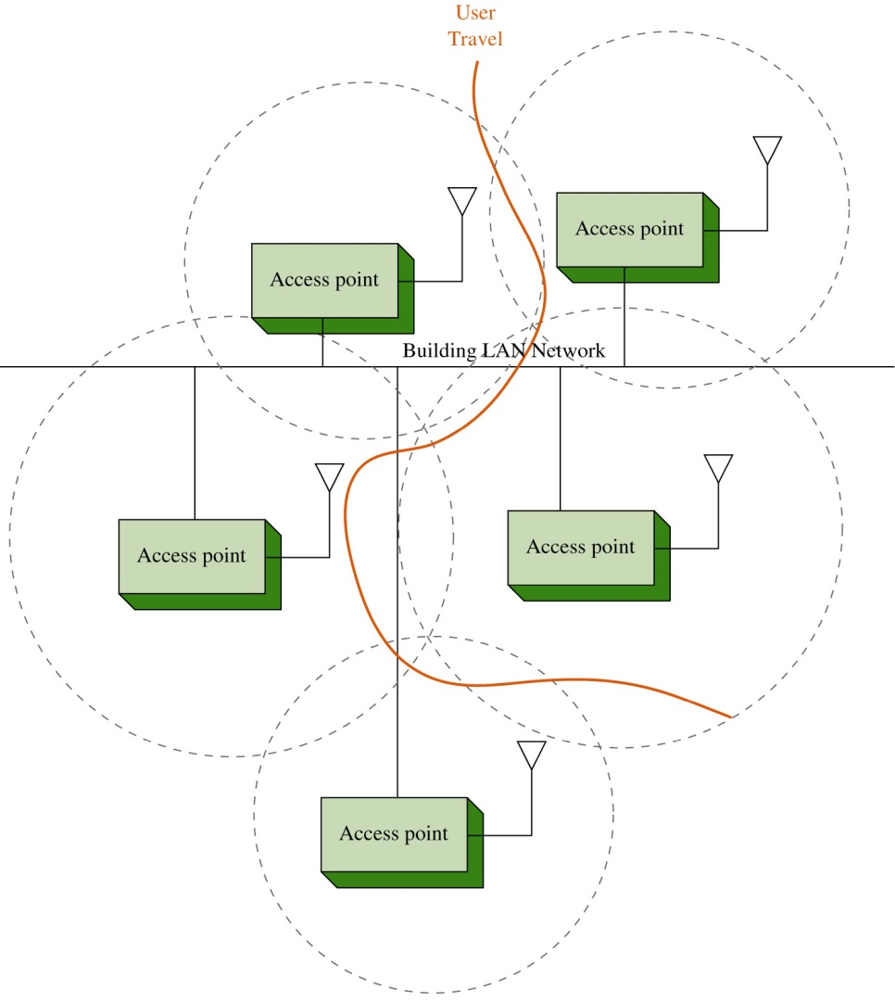
Indoors
A solution is to place multiple wireless access points within the facility as shown. The mobile client will be able to maintain a connection as he travels through the workplace since the wireless client will automatically select the access point that provides the strongest signal level.
The access points can be arranged so that overlapping coverage of the workplace is provided thus enabling seamless roaming for the client.

Slide 35
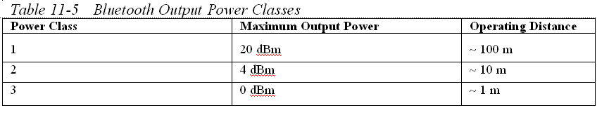
Bluetooth
This section examines Bluetooth which is based on the 802.15 standard.. Bluetooth was developed to replace the cable connecting computers, mobile phones, handheld devices, portable computers, and fixed electronic devices.
The information is transmitted over the 2.4 GHz ISM frequency band which is the same frequency band used by 802.11b,g,n.
There are three output power classes for Bluetooth.

Slide 36
Inquiry Procedure
When a Bluetooth device is enabled, it uses an inquiry procedure to determine if any other Bluetooth devices are available.
This procedure is also used to allow itself to be discovered.

Slide 37
Bluetooth
If a Bluetooth device is discovered, it sends an inquiry reply back to the Bluetooth device initiating the inquiry.
Next, the Bluetooth devices enter the paging procedure. The paging procedure is used to establish and synchronize a connection between two Bluetooth devices.
Once the procedure for establishing the connection has been completed, the Bluetooth devices will have established a piconet.
A piconet is an ad hoc network of up to eight Bluetooth devices such as a computer, mouse, headset, earpiece, etc. In a piconet, one Bluetooth device (the master) is responsible for providing the synchronization clock reference. All other Bluetooth devices are called slaves.

Slide 38
WiMAX
WiMAX (Worldwide Interoperability for Microwave Access) is a broadband wireless system and has been developed for use as broadband wireless access (BWA) for fixed and mobile stations and will be able to provide a wireless alternative for last mile broadband access in the 2 GHz to 66 GHz frequency range.
BWA access for fixed stations can be up to 30 miles while mobile BWA access is 3-10 miles. Internationally, the WiMAX frequency standard will be 3.5 GHz while the United States will use both the unlicensed 5.8 GHz and the licensed 2.5 GHz spectrum.

Slide 39
WiMAX
WiMAX also provides flexible channel sizes (e.g. 3.5 MHz, 5 MHz, and 10 MHz) which provides adaptability to standards for WiMAX worldwide. This also helps to ensure that the maximum data transfer rate is being supported.
For example, the allocated channel bandwidth could be 6 MHz and the adaptability of the WiMAX channel size allows it to adjust to use the entire allocated bandwidth.

Slide 40
WiMAX
The WiMAX (IEEE 802.16e) media access control (MAC) layer differs from the IEEE 802.11 Wi-Fi MAC layer in that the WiMAX system only has to compete once to gain entry into the network.
Once a WiMAX unit has gained access, it is allocated a time slot by the base station thereby providing the WiMAX with scheduled access to the network.
WiMAX operates in a collision free environment which improves channel throughput.

Slide 41
WiMAX
WiMAX has a range of up to 31 miles and it operates in both point-to-point point-to-multipoint configurations.
This can be useful in situations where DSL or cable network connectivity is not available.
WiMAX is also useful for providing the last mile connection. The last mile is basically the last part of the connection from the telecommunications provider to the customer. The cost of the last mile connection can be expensive which makes a wireless alternative attractive to the customer.

Slide 42
RFID
RFID – Radio Frequency Identification is a technique that uses radio waves to track and identify people, animal, objects, and shipments.
This is done by the principle of modulated backscatter. The term “backscatter” is referring to the reflection of the radio waves striking the RFID tag and reflecting back to the transmitter source with its stored unique
identification information.

Slide 43
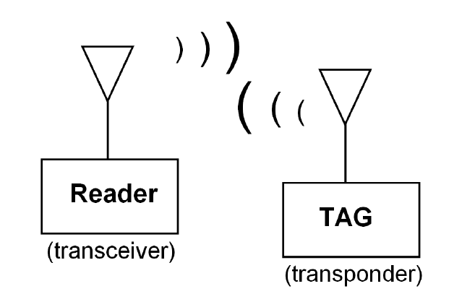
RFID System
The RFID system consists of two things:
- RFID tag (also called the RF transponder) which includes an integrated antenna and radio electronics
- Reader (also called a transceiver which consists of a transceiver and an antenna. A transceiver is the combination of a transmitter and receiver.
The reader (transceiver) transmits radio waves which activates (turns on) an RFID tag. The tag then transmits modulated data, containing its unique identification information stored in the tag, back to the reader. The reader then extracts the data stored on the RFID tag.

Slide 44
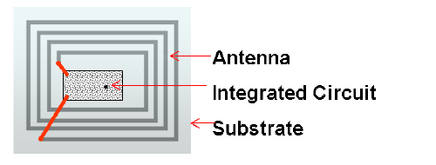
RFID Tag

Slide 45
RFID System
There are three parameters that define an RFID system. These include the following:
Means of powering the tag
Frequency of operation
Communications protocol
(also called the air interface protocol)

Slide 46
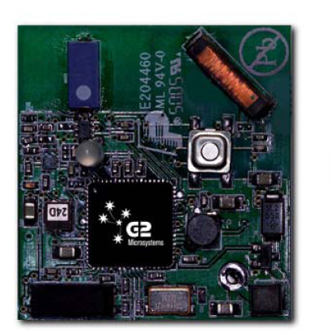
Powering the Taq
RFID tags are classified in three ways based on how they obtain their operating power. The three different classifications are passive, semi-active, and active.
Passive: Power is provided to the tag by rectifying the RF energy, transmitted from the Reader, that strikes the RF tag antenna. The rectified power level is sufficient to power the ICs on the tags and also provides sufficient power for the tag to transmit a signal back to the reader.
Semi-active: The tags use a battery to power the electronics on the tag but use the property of backscatter to transmit information back to the reader.
Active: Use a battery to power the tag and transmit a
signal back to the reader. Basically this is a radio
transmitter. New active RFID tags are incorporating
wireless Ethernet, the 802.11b – WiFi connectivity.

Slide 47
Mobile Communications
This is a brief summary of the some of the other wireless technologies currently available.
CDMA – Code Division Multiple Access
This is a communications system in which spread-spectrum techniques are used to multiplex more than one signal within a single channel.
LTE – Long Tem Evolution is a 4G Wireless communications standard. It has been designed to provide up to 10 times 3G network speeds

Slide 48
Mobile Communications
HSPA+ (Evolved High-Speed Packet Access) has been developed to provide network speeds comparable to LTE networks. Theoretical speeds for download are said to be 168Mbps and uplink of 22Mbps.
3G/4G was developed to provide broadband network wireless services. The standard defining 3G wireless is called international mobile communications, or IMT 2000.
4G (fourth generation) is the successor to 3G technology and it provides download speeds of 100 Mbps.
Edge (Enhanced Data GSM Evolution) provides download speeds of 384 Kbps.

